Slide 1
Scan Conversation (Part 1)
Course Code: CSC 3224
Course Title: Computer Graphics
Dept. of Computer Science
Faculty of Science and Technology
Lecture No: | 04 | Week No: | 03 | Semester: | Fall 2023-2024
Lecturer: | Shahnaj Parvin, sparvin@aiub.edu

Slide 2
Lecture Outline
What is Scan Conversation?
What is Rasterisation?
What is Incremental Algorithm?
Characteristics of Incremental Algorithm.
DDA Line Incremental Algorithm (Derivation)
DDA Line Incremental Algorithm (Mathematics)
Disadvantages of DDA Line Incremental Algorithm
Midpoint Line Algorithm (Derivation)
Midpoint Line Algorithm (Mathematics)
Advantages of Midpoint Line Algorithm

Slide 3
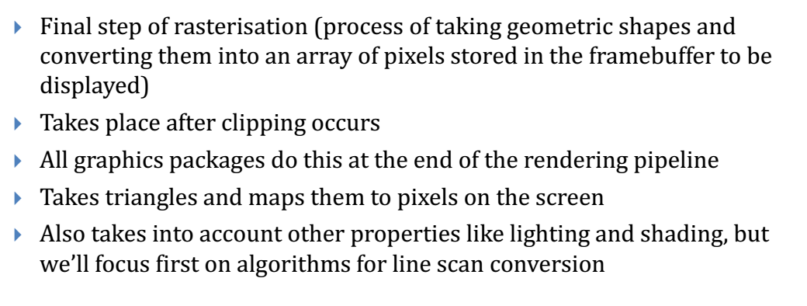
Scan Conversation
Modify as appropriate…..

Slide 4
Rasterisation
Rasterisation (or rasterization) is the task of taking an image described in a vector graphics format (shapes) and converting it into a raster image (pixels or dots) for output on a video display or printer, or for storage in a bitmap file format.

Slide 5
Incremental Algorithm
Incremental Algorithm is a line drawing algorithm
Start from initial pixel to reach final pixel to draw a line

Slide 6
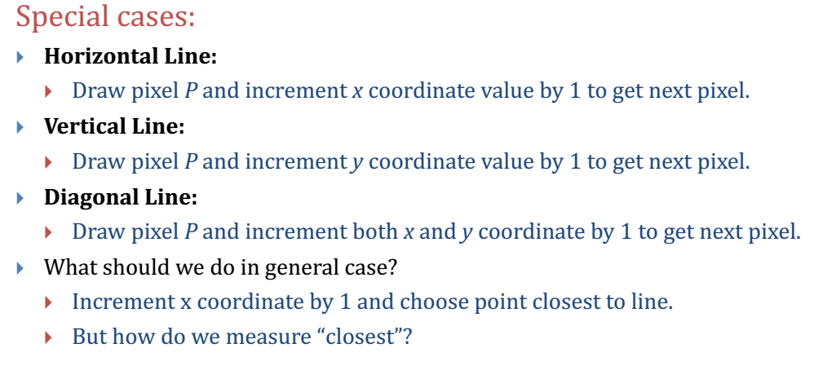
Incremental Algorithm
Finding the next pixel

Slide 7
Incremental Algorithm
Requirements
Three Requirements:
Integer Pixel Grid
Slope
Disjoint Pixel

Slide 8
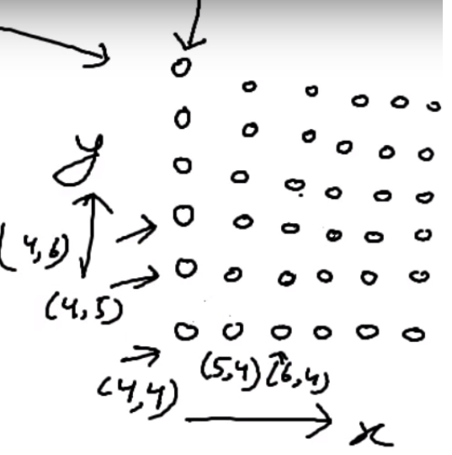
Incremental Algorithm
Integer Pixel Grid

Slide 9
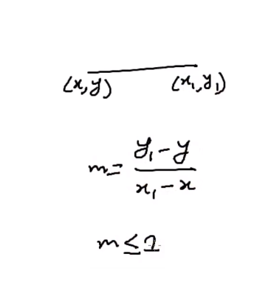
Incremental Algorithm
Slope

Slide 10
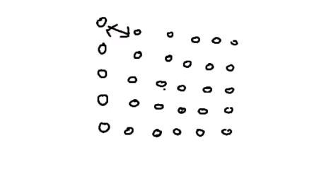
Incremental Algorithm
Disjoint Pixel

Slide 11
Digital Differential Analyzer (DDA)
Bresenham's Incremental Algorithm
In computer graphics, a digital differential analyzer (DDA) is hardware or software used for interpolation of variables over an interval between start and end point. DDAs are used for rasterization of lines, triangles and polygons.(graphics algorithm)

Slide 12
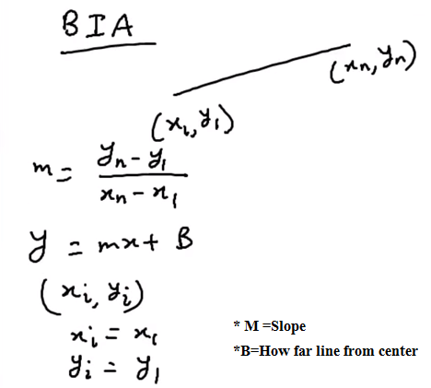
Digital Differential Analyzer (DDA)
Derivation

Slide 13
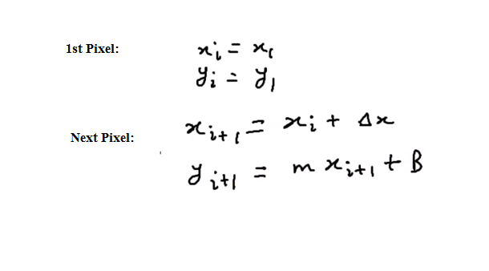
Digital Differential Analyzer (DDA)
Derivation (if m<1)

Slide 14
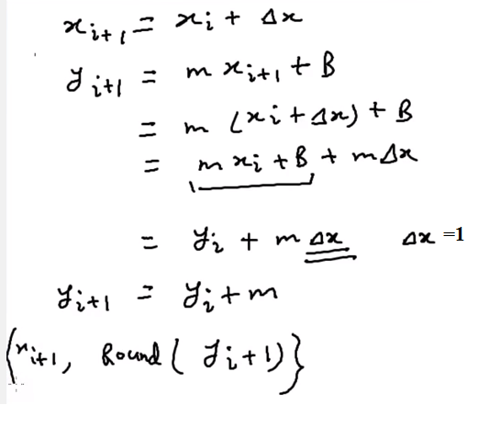
Digital Differential Analyzer (DDA)
Derivation

Slide 15
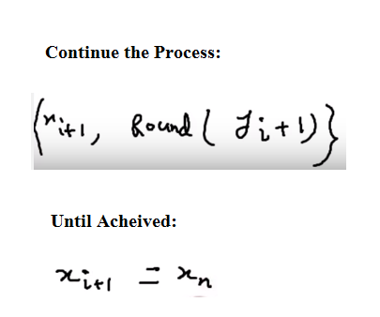
Digital Differential Analyzer (DDA)
Derivation (if m<1)

Slide 16
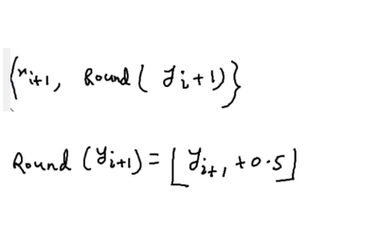
Digital Differential Analyzer (DDA)
Derivation (if m<1)

Slide 17
Digital Differential Analyzer (DDA)
Derivation (if m>1 and m=1)
if m>1
x1 = round(x + 1 /m)
y1 = y + 1
if m=1
x1=x+1
y1=y+1

Slide 18
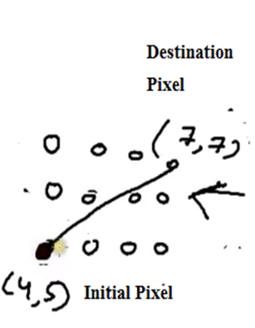
Digital Differential Analyzer (DDA)
Mathematics (Question)

Slide 19
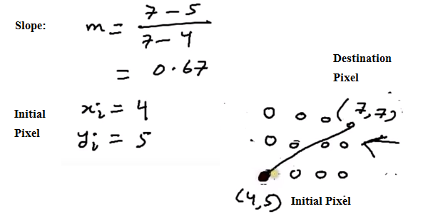
Digital Differential Analyzer (DDA)
Mathematics (Solve): Calculate Slope m and 1st Pixel

Slide 20
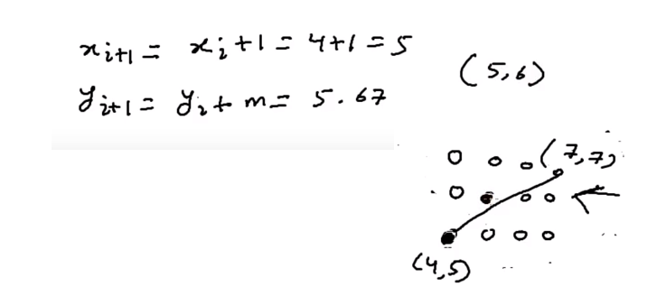
Digital Differential Analyzer (DDA)
Mathematics (Solve): Calculate 2nd pixel

Slide 21
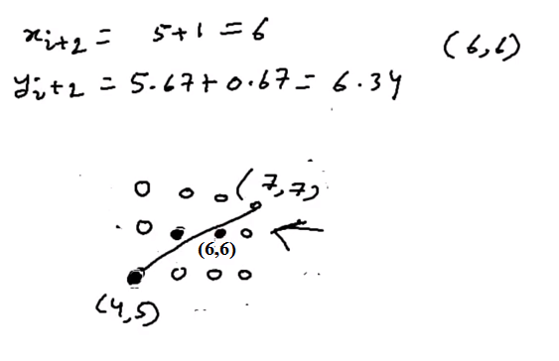
Digital Differential Analyzer (DDA)
Mathematics (Solve): Calculate 3rd pixel

Slide 22
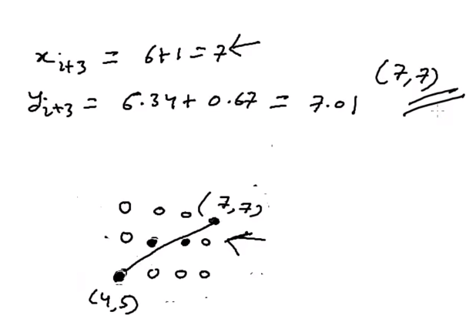
Digital Differential Analyzer (DDA)
Mathematics (Solve): Calculate Final pixel

Slide 23
Digital Differential Analyzer (DDA)
Disadvantages
Floating point arithmetic in DDA algorithm is still time consuming. The algorithm is orientation dependent. Hence end point accuracy is poor.
Although DDA is fast, the accumulation of round-off error in successive additions of floating point increment, however can cause the calculation pixel position to drift away from the true line path for long line segment

Slide 24
Bresenham's Mid Point Line Algorithm
Introduction
The Midpoint line algorithm is an incremental line plotting algorithm i.e. at each step we make incremental calculations based on preceding step to find next y value, in order to form a close approximation to a straight line between two points.

Slide 25
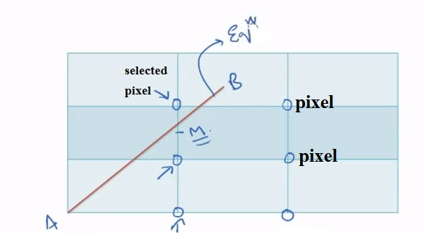
Bresenham's Mid Point Line Algorithm
Concept

Slide 26
Bresenham's Mid Point Line Algorithm
Concept
Equation of Line:
y=mx+B
Function of Line:
F(x,y)= ax+by+c

Slide 27
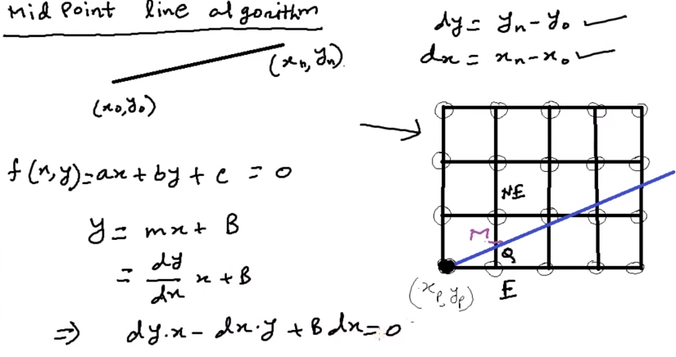
Bresenham's Mid Point Line Algorithm
Derivation

Slide 28
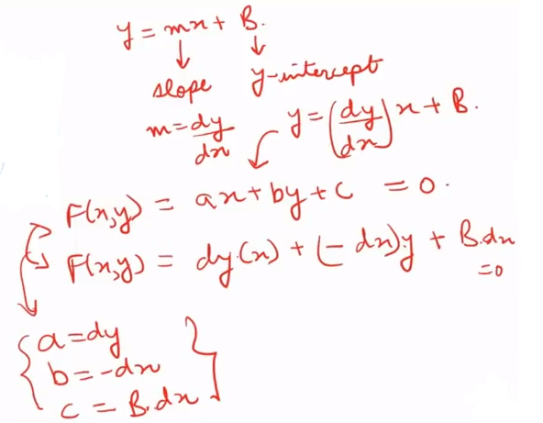
Bresenham's Mid Point Line Algorithm
Derivation

Slide 29
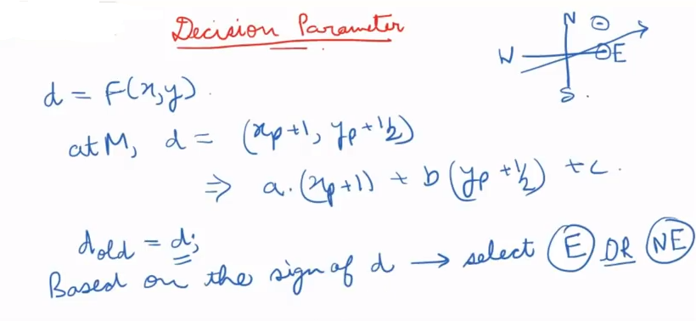
Bresenham's Mid Point Line Algorithm
Derivation

Slide 30
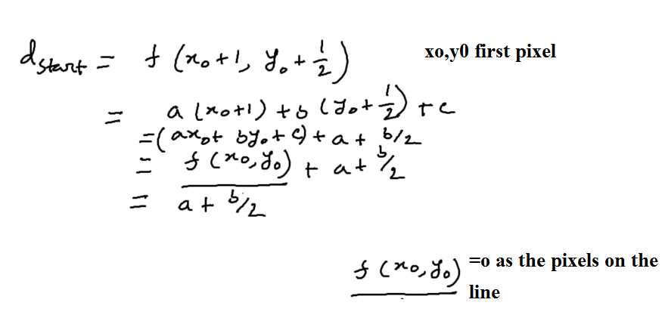
Bresenham's Mid Point Line Algorithm
Derivation (Find Dstart)

Slide 31
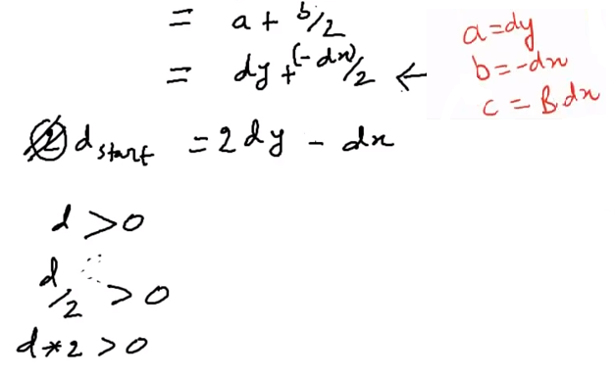
Bresenham's Mid Point Line Algorithm
Derivation (Find Dstart)

Slide 32
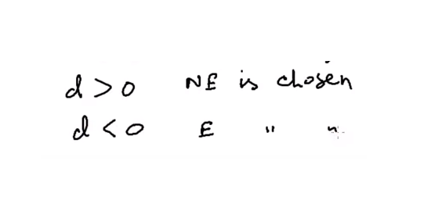
Bresenham's Mid Point Line Algorithm
Derivation (How to Choose E / NE)

Slide 33
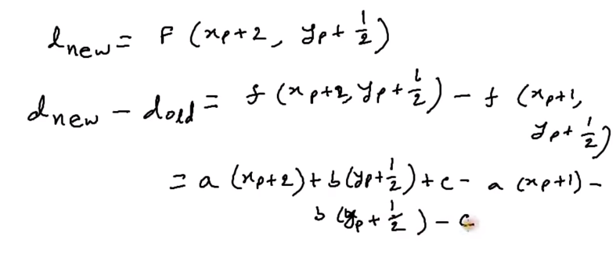
Bresenham's Mid Point Line Algorithm
Derivation (If E is chosen)

Slide 34
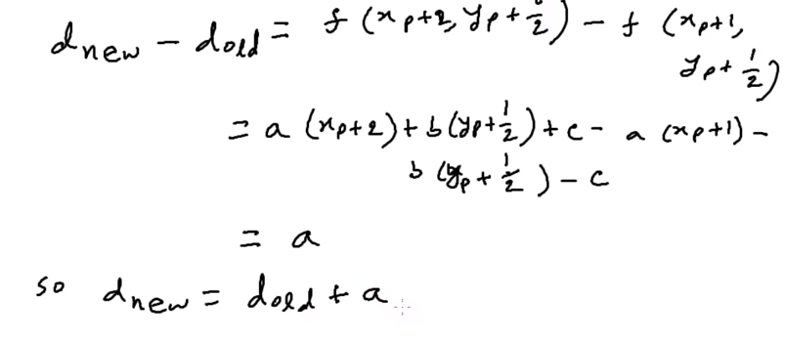
Bresenham's Mid Point Line Algorithm
Derivation (If E is chosen)

Slide 35
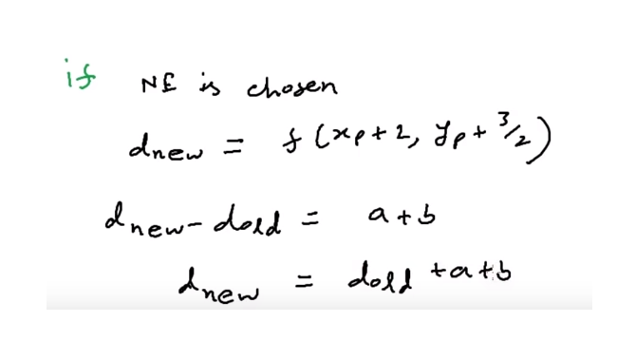
Bresenham's Mid Point Line Algorithm
Derivation (If NE is chosen)

Slide 36
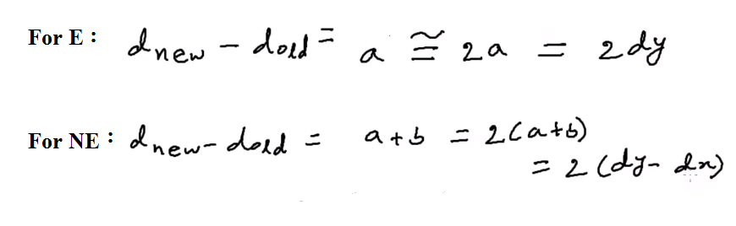
Bresenham's Mid Point Line Algorithm
Derivation (Adjustment with value 2)

Slide 37
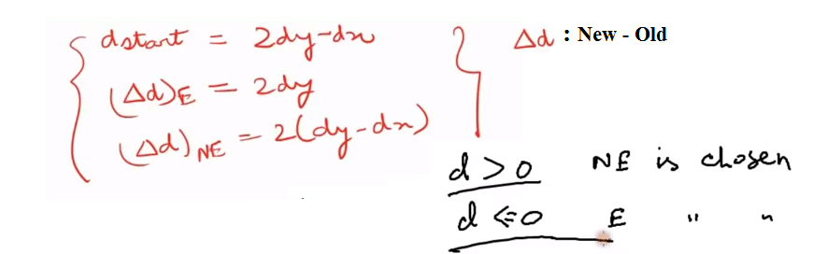
Bresenham's Mid Point Line Algorithm
Derivation (Summary)

Slide 38
Bresenham's Mid Point Line Algorithm
Advantages
Incremental Method
No Round Function
More accurate position
Only Arithmetic Function

Slide 39
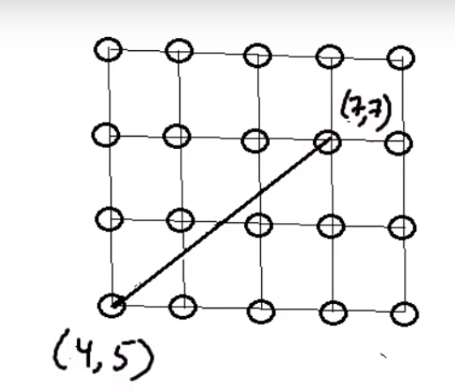
Bresenham's Mid Point Line Algorithm
Mathematics : Question

Slide 40
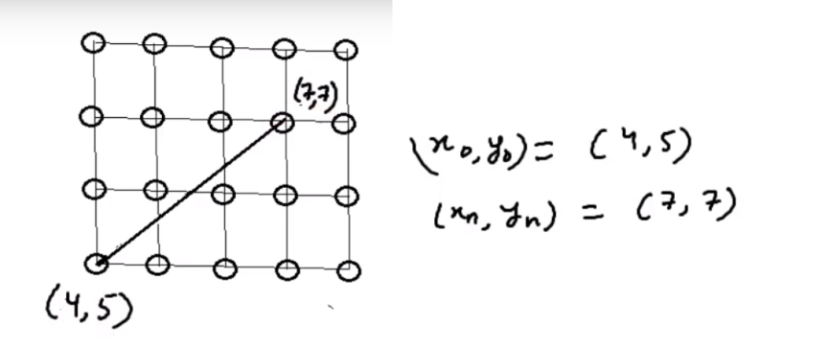
Bresenham's Mid Point Line Algorithm
Mathematics: Solve

Slide 41
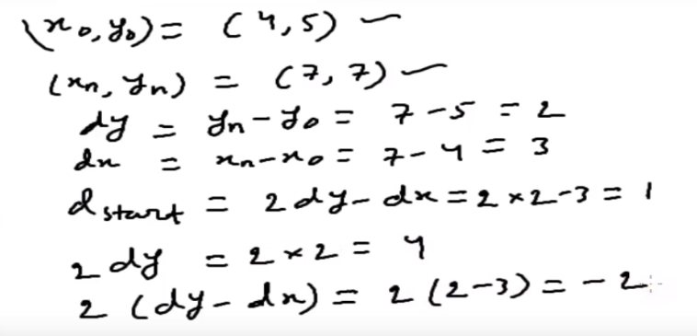
Bresenham's Mid Point Line Algorithm
Mathematics

Slide 42
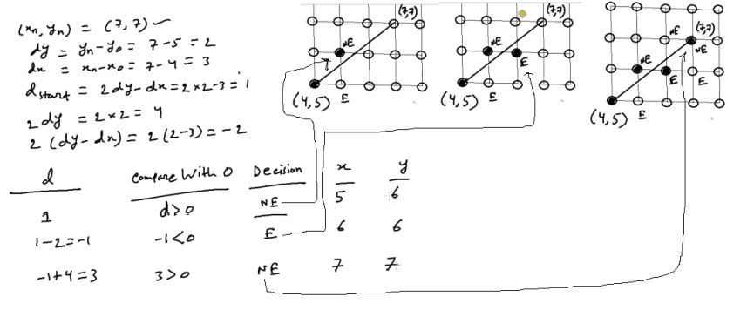
Bresenham's Mid Point Line Algorithm
Mathematics

Slide 43
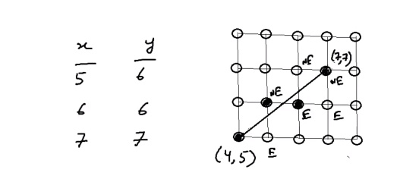
Bresenham's Mid Point Line Algorithm
Mathematics

Slide 44
Bresenham's Mid Point Line Algorithm
Mathematics

Slide 45
Books
Foley, van Dam, Feiner, Hughes, Computer Graphics: principles and practice, Addison Wesley, Second Edition.
Schaum's Outline of Theory & Problems of Computer Graphics.
Peter Shirley Steve Marschner , “Fundamental of computer graphics”, Third Edition.

Slide 46
References
Chapter 3: Basic Raster Graphics Algorithm for Drawing 2D Primitives.
Foley, van Dam, Feiner, Hughes, Computer Graphics: principles and practice, 2nd ed.
https://www.slideshare.net/mohammedarif89/intro-to-scan-conversion
https://en.wikipedia.org/wiki/Rasterisation
http://resources.mpi-inf.mpg.de/departments/d4/teaching/ws200708/cg/slides/
CG16-RasterizationClipping.pdf
https://www.tutorialspoint.com/computer_graphics/line_generation_algorithm.htm
https://en.wikipedia.org/wiki/Digital_differential_analyzer_(graphics_algorithm)
https://www.slideshare.net/ManikanthKummarikunt/dda-algorithm-97720869
https://www.slideshare.net/drishtibhalla/mid-point-line-algorithm
https://en.wikipedia.org/wiki/Bresenham%27s_line_algorithm

Slide 47
Bresenham's Mid Point Line Algorithm
Slop(m) < 1
d_{start} = 2d_{y}-d_{x}
when d>0 ----- select NE
d_{new} = d_{old} + 2(d_{y}-d_{x})
x_{i+1} = x_{i}+1
y_{i+1} = y_{i}+1
when d<=0 ----- select E
d_{new} = d_{old} + 2d_{y}
x_{i+1} = x_{i}+1
y_{i+1} = y_{i}

Slide 48
Bresenham's Mid Point Line Algorithm
Slop(m) > 1
d_{start} = 2d_{x}-d_{y}
when d>0 ----- select NE
d_{new} = d_{old} + 2(d_{x}-d_{y})
x_{i+1} = x_{i}+1
y_{i+1} = y_{i}+1
when d<=0 ----- select N
d_{new} = d_{old} + 2d_{x}
x_{i+1} = x_{i}
y_{i+1} = y_{i}+1

